Slide 1


Workshop #1: Introduction
Dr Ben Dickins
ENG128, Monday 09.00-12.00

Slide 2
Summary of Sections
What is R?
Simple Codes (arithmetic, storing values)
Reading Data (direct entry, data frames)
Object Types (vectors, arrays, lists)
Data Wranging (re-organising data for analysis)
Functions (built-in only)
Basic Plots (scatter, box and whiskers)
Summary Statistics (summarising, correlations)
Basic Statistics (statistical tests, power calculations)
Sample Size (power calculations)
Coda (summaries)

Slide 3


R Websites
R is a free software environment for statistical computing and graphics. It compiles and runs on a wide variety of UNIX platforms, Windows and MacOS.
http://www.r-project.org/
RStudio is a set of integrated tools designed to help you be more productive with R.
http://www.rstudio.com

Slide 4
Installing R
From Many Computer Rooms
Including this one: search for RStudio in Start Menu.
On Other Managed PCs
Virtualised via the “Software Hub”: load R then Rstudio.
From you own computer (Linux/MacOS/Windows)
Download an R installer from here (select a nearby mirror site): http://mirrors.ebi.ac.uk/CRAN/
Choose the Open Source, Desktop edition of RStudio from here: https://www.rstudio.com/products/RStudio/
Looking for “bleeding-edge” updates: http://r.research.att.com/

Slide 5
Getting Workshop Materials
The materials for this workshop (including this PowerPoint) can be found here:
https://github.com/tethig/revanent
If you’ve not already done so, click the “Clone or download” button and select “Download "ZIP”.
Unzip the “revanent-master” folder and move it into your OneDrive folder.

Slide 6
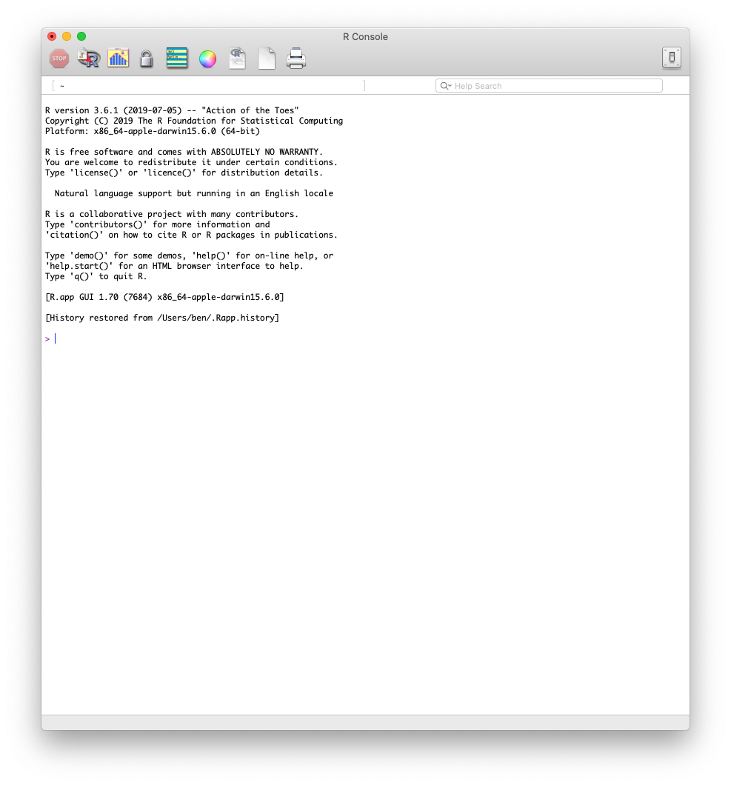
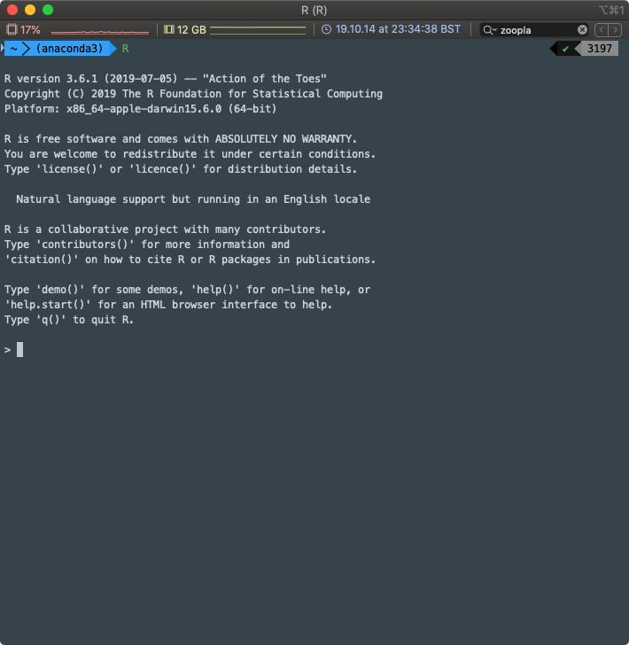
R Environment
Terminal emulator
Graphical User Interface

Slide 7
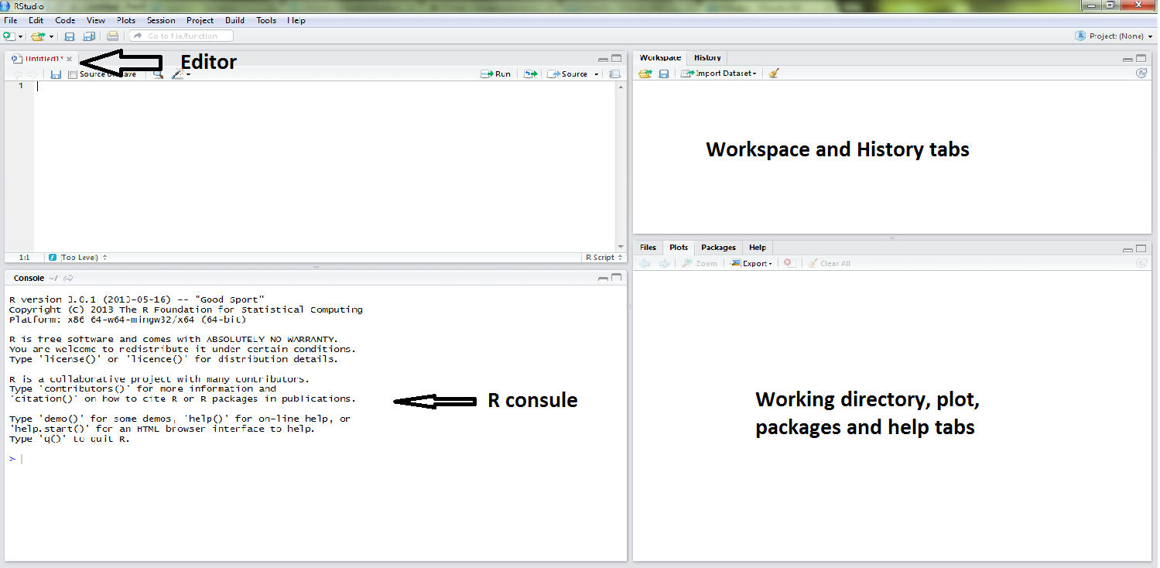
RStudio

Slide 8
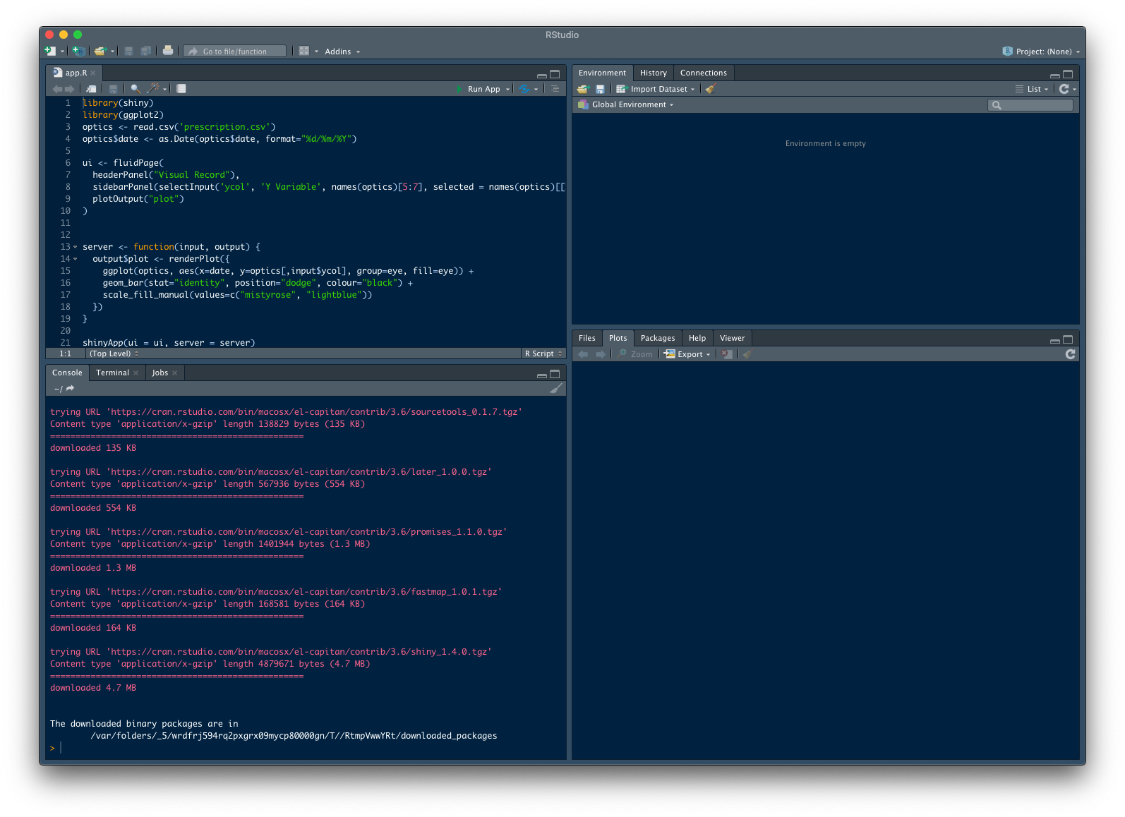
Dark Mode ☺
Rstudio is an Integrated Development Environment (IDE)

Slide 9
Getting Help
Getting help from R built-in facility. You can call it by “?” as follows:
> ?function
Note that “>” is the prompt command, which means R is expecting you to input a command. You should not type it in R.
Do it yourself
> ?mean ↵

Slide 10
Fuzzy Search for Help
Do you need more information or can’t you find what you are looking for? Use “??”:
>??"function"
Also you can obtain more details on features specified by special characters:
>?"[["

Slide 11
Note: “↵” means press “Enter” or “Return” button on your keyboard if you are typing in console.
Do it yourself: try the following commands
> ??mean↵
>?"%*%"↵
Let’s try something new. Type the following command
> q() ↵
What does happen?

Slide 12
Avoiding Bracket Meltdown
NOTE: If a command is not complete at the end of a line, R will give a different prompt, by default is
+
You will experience this a lot. So be careful with opening and closing your brackets, for example try
> mean(c(1,2,4,3)
or
> q(

Slide 13
Getting Examples
Do you need example?
> example(topic)
Do it yourself: try the following commands
> example(mean) ↵
> example(sd) ↵

Slide 14
Simple Codes
Arithmetic and storing values

Slide 15
Expression
There are three types of expression in R
Numbers: 1,2,0.2,-5 , etc
Strings: alphabets or anything that is input by “” into R
Logical: TRUE/FALSE

Slide 16
Expression
Numbers:
> 2+3
Strings:
> “Hello”
TRUE/FALSE
> 3<4
> 2+4 ==4

Slide 17
Arithmetic Operators
x + y sum
x - y subtract
x * y multiply
x / y divide
x ^ y power

Slide 18
Arithmetic Operators
Do it yourself:
> 2+4↵
> 2^3↵
> 850/10↵
> 220-20↵

Slide 19
Storing Values
In all programming languages we can store values in variables and access them later.
This can be done in various ways using a selection of assignment operators. The most commonly used one is “<-”, see the example below:
> x<- 3
> y<- "Hey!"
Note: In most contexts the ‘=’ operator can be used as an alternative.

Slide 20
Reading Data
Direct entry, Data frames

Slide 21
Inputting Data
R allows users to input data using a wide range methods.
Directly by typing the data into R (using scan())
Reading external files: txt, csv, SAS, SPSS, Excel.
I encourage you to learn different methods, but we will cover a common and robust use case: handling csv files¹.
¹ Find out more: https://www.datacamp.com/community/tutorials/r-data-import-tutorial

Slide 22
Inputting Data
Direct Method
You can directly input data points one by one using scan()
This is called a base function.
Do it yourself
> x <- scan() ↵
13 2 1.2 3 18 6 ↵
↵
> x ↵

Slide 23
Inputting Data
External Files
External files come in various formats and a number of convenience functions are available:
read.table()
read.csv()
read.delim()
Before we need to find out our working directory:
Do it yourself
> getwd()↵

Slide 24
Inputting Data
Setting Paths
You can use dir() to find what is in each directory and setwd() to change to a new working directory.
Do it yourself: We are going to change working directory to the revanent-master folder we put in the OneDrive folder earlier:
> dir()↵
> setwd("C://PATH/TO/revanent-master")↵
> dir()↵

Slide 25
Do it yourself: Read the simple.txt data set and store it in a data frame called easy.
> easy <- read.table('simple.txt', header = TRUE, sep = "\t") ↵
Let us look at the first 6 lines of the data:
> head(easy)↵
There’s also an RStudio command (note uppercase letter) for looking at a data frame:
> View(easy)↵
Now plot the data!
> plot(easy) ↵

Slide 26
Inputting Data
Comma Separated
Do it yourself: Read the smoking.csv data set and store it in a data frame called smoking.
> smoking <- read.csv('smoking.csv', header = TRUE)↵
Let’s look at the data too:
> View(smoking)↵

Slide 27
Data Frames
A data frame is a list of variables, each of the same length but not necessarily of the same type.
The top line of the table, called the header, contains the column names.
Each horizontal line afterward denotes a data row, which begins with the name of the row, and then followed by the actual data.

Slide 28
Built-in Data Frames
We can also call built-in data frames in R for our tutorials.
This can be done by using the data()command.
For example, here is a built-in data frame in R, called mtcars.

Slide 29
Do it yourself: Call the R built-in data set mtcars as follows:
> data(mtcars) ↵
Let us look at the first 6 lines of the data
> head(mtcars) ↵
Find out more about it:
> ?mtcars ↵

Slide 30
The Environment
Do it yourself: See all the objects and data in your environment:
> ls() ↵
Or you can see it in the top right corner of RStudio (Environment tab).

Slide 31
Object Types
Vectors, Matrices, Arrays and Lists

Slide 32
Vectors
A vector is simply a list of values. R relies on vectors for many of its operations, such as plots, basic statistics and statistical modelling.
Values of vector can be numbers, strings, logical values or any other types, as long as they are all same type.

Slide 33
Vectors
Example: set up a vector named x, say, consisting of five numbers, namely 10.4, 5.6, 3.1, 6.4 and 21.7, use the R command
> x <- c(10.4, 5.6, 3.1, 6.4, 21.7)
This is an assignment statement using the function c().
In most contexts the ‘=’ operator can be used as an alternative.

Slide 34
Vectors
Do it yourself:
> c(1,3,5) ↵
> c("H", "A", "B")↵
> c(TRUE, 2, "Sky") ↵
> y <- c(x, 0, x) ↵
> y ↵

Slide 35
Vectors
Vectors can be used in arithmetic expressions, in which case the operations are performed element by element.
> v <- 2*x + y + 1 ↵
> sum((x-mean(x))^2)/(length(x)-1) ↵
> sort(x) ↵

Slide 36
Matrix
Matrices are usually defined in R by function matrix()
> matrix(vector, ncol = n, nrow = m)
You can define a diagonal matrix using the diag() function:
> diag(x, ncol=n, nrow= m)

Slide 37
Matrix
Do it yourself:
Define a matrix of 3 rows and 2 columns with following vector
c(1,6,5,3,2,7)
Define a diagonal matrix of 5 columns and 5 rows with the diagonal values of (3,6,9.1,-0.5,0.12)

Slide 38
Array
An array can be considered as a multiply subscripted collection of data entries, for example numeric.
R allows simple facilities for creating and handling arrays, and in particular the special case of matrices.
A vector can be used by R as an array only if it has a dimension vector as its dim attribute.
Suppose, for example, z is a vector of 1500 elements. The assignment
> dim(z) <- c(3,5,100)

Slide 39
Array
Do it yourself:
> x <- c(1,6,5,3,2,7,1,6,5,3,2,7) ↵
> array(x, dim = c(3,2,2)) ↵
# or dim(x)<- c(3,2,2)

Slide 40
Lists
lists are a general form of vector in which the various elements do not need to be of the same type, and are often themselves vectors or lists.
Lists provide a convenient way to return the results of a statistical computation.
list(name="Mary", spouse="Todd", no.children=3, child.ages=c(4,7,9))

Slide 41
Data Wrangling
re-organising data for analysis

Slide 42
Vector Refresher and Shortcuts
Do it yourself: vector shortcuts:
> c(3,4,5,6,7,8) ↵
# the c() function concatenates anything (including other vectors)
> 3:8 ↵
# the `:` is a shortcut to give you all the integers in between
> 1:5*2 ↵
# multiplying each number by 2 gives you different spacing
> seq(2,10, by=2) ↵
# the equivalent using seq() function
> rep(3:8, times=2)↵
# the rep() function repeats a vector `times` times
> rep(3:8, each=2)↵
# or you can repeat the elements (try both if you want)

Slide 43
Refresher: Types of Object
Do it yourself: Let’s make some objects:
> M <- matrix(seq(1,31,by=2), 4, 4) ↵
> L <- list(a=1, b=1:3, c=10:100) ↵
> NumV <- 1:20 ↵
> FacV <- factor(rep(letters[1:5],each=4)) ↵
# not sure what letters is doing? Take a look…
Now take a look at these objects. What types of object are they? Use str() to help you.
Factors are important in analysis.

Slide 44
Subsetting Objects
Do it yourself: Take subsets of letters
> letters[c(2:4,26)] ↵
# can you make sense of this?
Now take subsets of the matrix we just made:
> M[2,3] ↵
> M[2,] ↵
> M[,3] ↵
> M[2,2:4] ↵
# can you make sense of these?
This also works with data frames and their cousins called `tibbles` (more next week).

Slide 45
Base Aggregation Functions (*apply)
Function | Mnenomic | What it does | Example (Try them!)
apply() | -- | apply “function” to rows OR columns of a matrix | apply(M, 1, min) apply(M, 2, max)
lapply() | list | apply function to each element in a list and emit list | lapply(L, FUN = length) lapply(L, FUN = sum)
sapply() | simplifying | apply function to each element in list and output list | sapply(L, FUN = length) sapply(L, FUN = sum)
tapply() | per type | apply function to subsets of a vector (defined by other vector) | tapply(NumV, FacV, sum)
by() | by column | apply to subsets of columns in a data frame (defined by vector) | by(warpbreaks[,1:2], tension, summary)
aggregate() | -- | equivalent to by() but outputs to a new data frame | aggregate(breaks, list(wool, tension), summary)
Notes:
Acknowledgement: Reworked from Joran’s answer here: http://tinyurl.com/omrhtm7

Slide 46
Attaching a Dataset
Do it yourself: Many datasets are available:
> library(help = "datasets") ↵
Let’s get one of them and find out about it:
> data(warpbreaks)↵
> ?warpbreaks ↵
> View(warpbreaks)
and then attach the data to memory:
> attach(warpbreaks)↵
This means that variable names will be remembered.

Slide 47
Advanced Aggregation
Function | Mnenomic | What it does | Example (Try them!)
apply() | -- | apply “function” to rows OR columns of a matrix | apply(M, 1, min) apply(M, 2, max)
lapply() | list | apply function to each element in a list and emit list | lapply(L, FUN = length) lapply(L, FUN = sum)
sapply() | simplifying | apply function to each element in list and output list | sapply(L, FUN = length) sapply(L, FUN = sum)
tapply() | per type | apply function to subsets of a vector (defined by other vector) | tapply(NumV, FacV, sum)
by() | by column | apply to subsets of columns in a data frame (defined by vector) | by(warpbreaks[,1:2], tension, summary)
aggregate() | -- | equivalent to by() but outputs to a new data frame | aggregate(breaks, list(wool, tension), summary)
Notes:
Acknowledgement: Reworked from Joran’s answer here: http://tinyurl.com/omrhtm7

Slide 48
Detaching a Dataset
Always do it !
> detach(warpbreaks)↵
This means that variable names will be forgotten.
How do we refer to columns is detached objects?
The old-fashioned way:
> warpbreaks[,3] ↵
By column header using $ notation (very useful!):
> warpbreaks$tension ↵

Slide 49
Functions
Just looking at built-in functions for now…

Slide 50
R built-in functions
Almost everything in R is done through functions.
R built-in functions are divided to:
Numeric functions
Character functions
Random number generators
Functions for logical/missing data
Basic reporting and statistical functions

Slide 51
R built-in functions
General form
Separate arguments by comma
function(arg_1, arg_2, …, arg_k)
Name of the function
Arguments will be always between brackets
Use as many arguments as required
Order is not important, as long as you specify what argument you are using, e.g. function(arg1 = x, argk = y, arg2 = z).
Arguments can be required or optional.

Slide 52
R built-in functions
Numeric Functions
Function | Description
abs(x) | absolute value
sqrt(x) | square root
round(x, digits=n) | round(3.475, digits=2) is 3.48
cos(x), sin(x), tan(x) | also acos(x), cosh(x), acosh(x), etc.
log(x) | natural logarithm
log10(x) | common logarithm
exp(x) | e^x

Slide 53
R built-in functions
Character Functions
Search for matches to argument pattern within each element of a character vector
grep(pattern, x ,ignore.case=FALSE, fixed=FALSE)
sub(pattern, replacement,x, ignore.case =FALSE, fixed=FALSE)

Slide 54
R built-in functions
Character Functions
Do it yourself:
> test1 <- c("ATG","GTA","AGT", "TCG","ATG")
> i <- grep("ATG", test1, fixed=TRUE)
> i
> test1[i]
> sub("ATG","AGT",test1)

Slide 55
R built-in functions
Statistical Probability Functions
Function | Description
dnorm(x) pnorm(q) qnorm(p) rnorm(n, m=0,sd=1) | Normal density function (by default m=0 sd=1)
dbinom(x, size, prob) pbinom(q, size, prob) qbinom(p, size, prob) rbinom(n, size, prob) | Binomial distribution where size is the sample size and prob is the probability of a heads (pi)
dpois(x, lamda) ppois(q, lamda) qpois(p, lamda) rpois(n, lamda) | Poisson distribution with m=std=lamda

Slide 56
Basic Plots
Scatter and box plots with the base package

Slide 57
Plots
Plots in R:
Plots of a single variable
Plots of two variables
Plots of three or more variables

Slide 58
Plots
plot is generic function for plotting of R objects.
For simple scatter plots, plot.default will be used. However, there are plot methods for many R objects, including functions, data.frames, density objects, etc.
See methods(plot)

Slide 59
Plots: single variable
Scatter Plot
Do it yourself: Let us generate 100 random samples from a standard normal distribution, N(0,1):
> y <- rnorm(100, mean = 0, sd = 1) ↵
Produce a simple scatter plot:
> plot(y) ↵
Find out more about the plot function:
> ?plot ↵

Slide 60
Plots: single variable
Scatter Plot
Do it yourself: Try different plot types for y:
> plot(y, type = 'b') ↵
> plot(y, type = 'l') ↵
> plot(y, type = 'h') ↵
Explain how different each plot is.

Slide 61
Plots: single variable
Scatter Plot
Note: type is a plot option which allows you to choose between points “p”, bars “h”, line “l” and both points and line “b”.
In general, options can be added in the R functions and are separated by “,”.
Common options for the plot function and shared with other graphics functions are: pch, xlab, ylab, xlim, ylim, cex, cex.lab, cex.axis, main and col.
You can set many of these globally with par().

Slide 62
Plots: two variables
Scatter Plot
Do it yourself: Select the variables for “horse power” and “miles per gallon” from the “mtcars” data frame and plot them against each other:
> head(mtcars) ↵
> plot(mtcars$hp, mtcars$mpg) ↵
Note the $ sign. It selects a vector from the data frame mtcars.

Slide 63
Plots: two variables
Boxplot with one predictor
You can use boxplot() to create a box and whiskers plot of a continuous variable affected by a predictor.
Do it yourself
> boxplot(mpg~am, data=mtcars) ↵

Slide 64
Plots: two variables
Saving your plot
You can use pdf() or tiff() to save your plot. Any changes you make to graphics will not be saved.
Do it yourself
> pdf(file="myplot.pdf", 7, 7) ↵
> par(col='red') ↵
> boxplot(mpg~am, data=mtcars) ↵
> dev.off() ↵

Slide 65
Summary Statistics
Summarising, Correlations

Slide 66
Summary Statistics
summary()
summary is a generic function used to produce result summaries of the results of various model fitting functions. Its general form is
summary(object, ...)
where object is an object for which a summary is desired. Object can be a data frame, matrix or a model.

Slide 67
Summary Statistics
summary()
Do it yourself: Use the summary function for data sets smoking and mtcars
> summary(smoking)
> summary(mtcars)
summary() calculates min, 1st and 3rd quartiles, median,
mean and max of each variable in the data frame.

Slide 68
Summary Statistics
sd() and var()
sd() and var() calculate standard deviation (SD) and the variance of a single vector. Variance-covariance matrix of a data frame can be calculated using the var() function.
Do it yourself: Calculate SD and variance mpg in mtcars data set.
> sd(mtcars$mpg)
> var(mtcars$mpg)

Slide 69
Summary Statistics
cor() and cor.test()
cor() calculates correlation coefficient ("pearson", "kendall", "spearman") for a pair of variables and the correlation matrix for more than two variables.
The significance of the linear relationship between two variables can be tested using cor.test().

Slide 70
Summary Statistics
cor() and cor.test()
Do it yourself: Calculate correlation coefficient of mpg and wt from the mtcars data set. Is there a significant relationship between these two variables?
> cor(mtcars$mpg, mtcars$wt)
> cor.test(mtcars$mpg, mtcars$wt)
Do it yourself: Calculate the correlation matrix for the mtcars data set.
> cor(mtcars)

Slide 71
Summary Statistics
A bit advanced: aggregate()
Sometimes you need to obtain the summary statistics of a data frame x grouped by a list of grouping elements.
For example death rate grouped by smokers and non-smokers.
Use aggregate() for this purpose
aggregate(x, by, FUN )

Slide 72
Summary Statistics
cor() and cor.test()
Do it yourself: Calculate the mean for the epilepsy grouped by the treatment/no treatment?
> aggregate(mtcars, by = list(row.names(mtcars)), FUN = "mean")
or
> aggregate(mtcars$mpg, by = list(row.names(mtcars)), FUN = "mean")

Slide 73
Basic Statistics
Statistical tests, Power calculations

Slide 74
Statistical Test
t.test()
Performs one and two sample (paired or independent) t-tests on vectors of data.
t.test(x, y = NULL,
alternative = c("two.sided", "less", "greater"), mu = 0, paired = FALSE, var.equal = FALSE,conf.level = 0.95)

Slide 75
Statistical Test
t.test()
Do it yourself:
x1 <- rnorm(100,0,1)
x2 <- rnorm(100,3,1)
t.test(x1, x2)
Try different options of the t.test and see how the analysis outcome changes.
NOTE: This is an illustrative example. In practice you must make sure the data comes from a normal distribution.

Slide 76
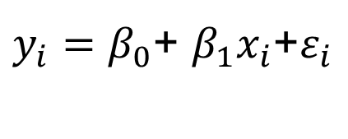
Statistical Test
Linear models
,
:
Here is a brief summary of some useful regression tools; see the excellent book by Faraway (2005) for detail and first rate explanations.
Let’s fit the simple linear regression model
$y_{i}=β_{0}$+ $β_{1}x_{i}$+$ε_{i}$
to data points (x_{i}, y_{i}) for i = 1, …, n.

Slide 77
Statistical Test
Linear Model
> x <- c(1,3,5,7)
> Y <- c(2,8,13,19)
> plot(x, y, xlab = "x", ylab = "y")
> # Fit the linear regression model
> lm_model <- lm(y ~ x)
> lm_model
> # Add the fitted line to the graph
> abline(lm_model)
> summary(lm_model)
> anova(lm_model)

Slide 78
Statistical Test
Other functions
Other useful functions are:
aov(formula) analysis of variance model
anova(fit,...) analysis of variance (or deviance) tables for one or more fitted model objects.
binom.test(), pairwise.t.test(), prop.test(), ...
Use help.search("test")

Slide 79
Sample Size
Power Calculations

Slide 80
Sample Size
power.t.test() computes power of test, or determine parameters to obtain target power.
power.t.test(n = NULL, delta = NULL, sd = 1, sig.level = 0.05,power = NULL,type = c("two.sample", "one.sample", "paired"), alternative = c("two.sided", "one.sided"), strict = FALSE)

Slide 81
Sample Size
Do it yourself:
> power.t.test(n = 20, delta = 1)
> power.t.test(power = .90, delta = 1)
> power.t.test(power = .90, delta = 1, alternative = "one.sided")

Slide 82
Coda
Summaries

Slide 83
Summary
A gentle introduction to R
Help and Example
Data types
Vectors and Matrices
Inputting data
R graphics
One, two and more variables
Summary Statistics

Slide 84
Summary
Summary Statistics
summary, sd, var and cor functions
aggregate
Common tests: t-tests, linear models and ANOVA
More advanced: logistic regression and survival analysis

Slide 85
Text Books and Resources
Try R supported by Code School:
http://tryr.codeschool.com/
R Bloggers:
http://www.r-bloggers.com
Gareth James, Daniela Witten, Trevor Hastie and Robert Tibshirani (2015). An Introduction to Statistical Learning with Applications in R, Springer.
Dobson A. J. and Barnett A. G. (2008). An introduction to Generalised Linear Models, CRC press.
Faraway J. (2005). Linear Models with R. Chapman & Hall.
Murrell Paul (2011). R Graphics , CRC press.

Slide 86
Thank You

